Slide 1
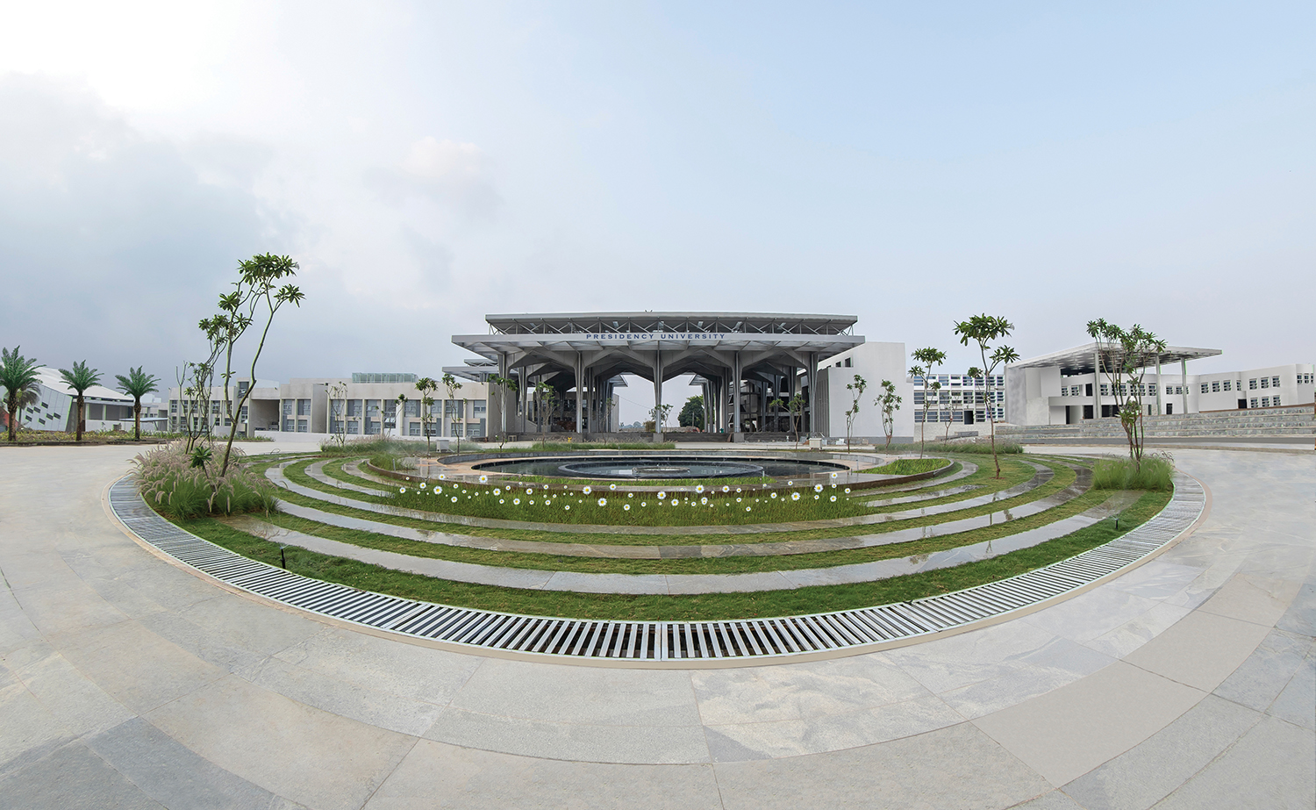

CSE3078 – Cryptography and Network Security
School of Computer Science and Engineering

Slide 2
Module 1
Introduction to Cryptography and types of Ciphers

Slide 3
Introduction to Cryptography
Definition
Cryptography is the science of using mathematics to encrypt and decrypt data - Phil Zimmermann
Cryptography is the art and science of keeping messages secure - Bruce Schneier

Slide 4
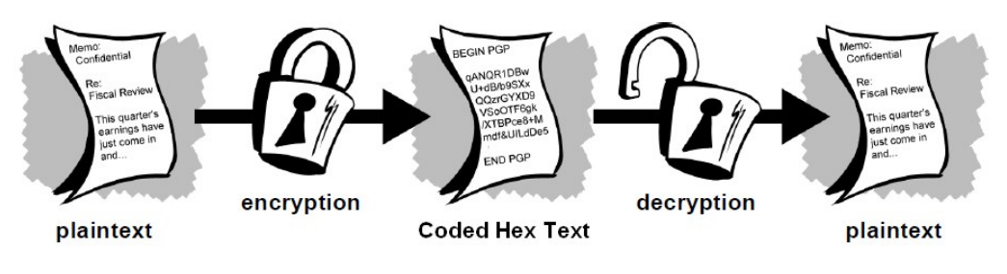
Terminologies

Slide 5
A message is plaintext (sometimes called cleartext).
The process of disguising a message in such a way as to hide its substance is encryption.
An encrypted message is ciphertext.
The process of turning ciphertext back into plaintext is decryption.

Slide 6
A cipher (or cypher) is an algorithm for performing encryption or decryption—a series of well-defined steps that can be followed as a procedure

Slide 7
Cryptosystem
A cryptosystem is an implementation of cryptographic techniques and their accompanying infrastructure to provide information security services.
A cryptosystem is also referred to as a cipher system.
The various components of a basic cryptosystem are as follows −
Plaintext
Encryption Algorithm
Ciphertext
Decryption Algorithm
Encryption Key
Decryption Key

Slide 8
OSI Security Architecture
“Security Architecture for OSI”
defines a systematic way of defining and providing security requirements
for us it provides a useful, if abstract, overview of concepts.

Slide 9
Aspects of Security
consider 3 aspects of information security:
security attack
security mechanism
security service

Slide 10
Security Attack
any action that compromises the security of information owned by an organization
information security is about how to prevent attacks, or failing that, to detect attacks on information-based systems
often threat & attack used to mean same thing
have a wide range of attacks
can focus of generic types of attacks
passive
active

Slide 11
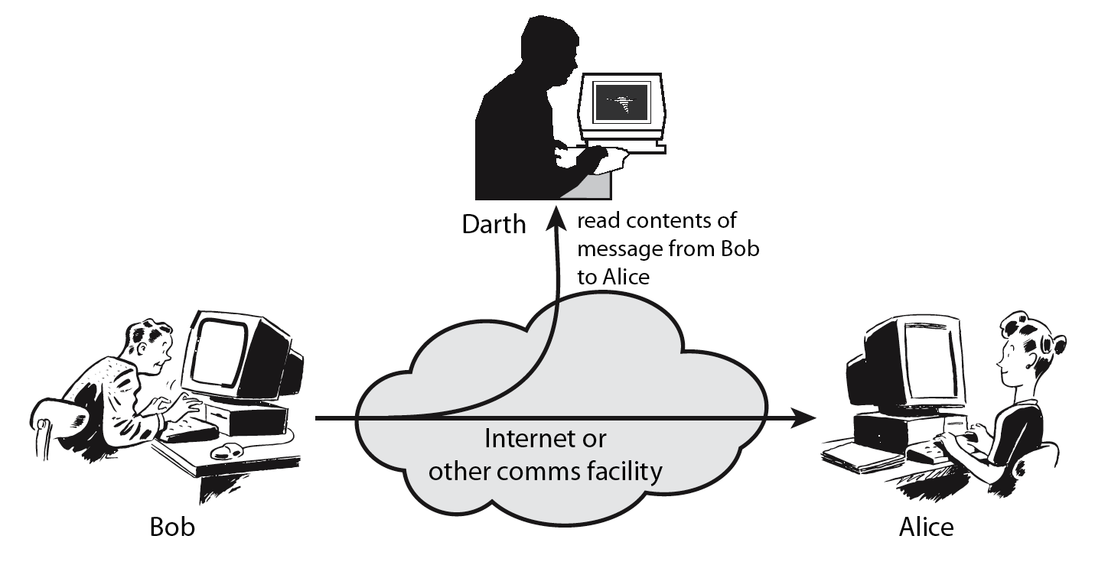
Passive Attacks

Slide 12
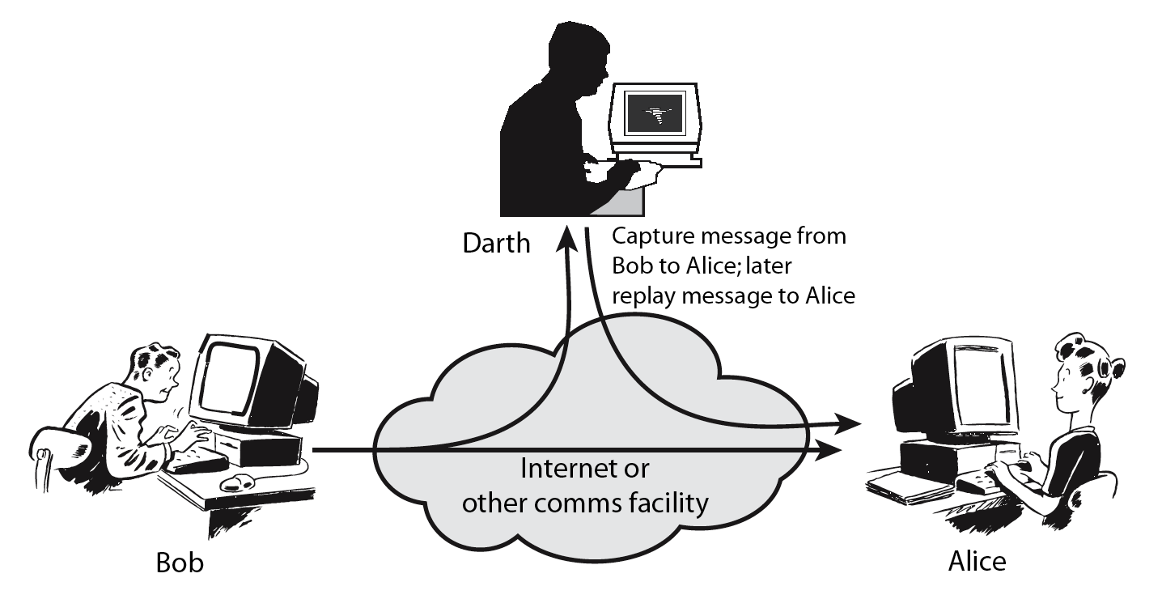
Active Attacks

Slide 13
Security Service
enhance security of data processing systems and information transfers of an organization
intended to counter security attacks
using one or more security mechanisms
often replicates functions normally associated with physical documents
which, for example, have signatures, dates; need protection from disclosure, tampering, or destruction; be notarized or witnessed; be recorded or licensed

Slide 14
Security Services
X.800:
“a service provided by a protocol layer of communicating open systems, which ensures adequate security of the systems or of data transfers”
RFC 2828:
“a processing or communication service provided by a system to give a specific kind of protection to system resources”

Slide 15
Security Services (X.800)
Authentication - assurance that the communicating entity is the one claimed
Access Control - prevention of the unauthorized use of a resource
Data Confidentiality –protection of data from unauthorized disclosure
Data Integrity - assurance that data received is as sent by an authorized entity
Non-Repudiation - protection against denial by one of the parties in a communication

Slide 16
Security Mechanism
feature designed to detect, prevent, or recover from a security attack
no single mechanism that will support all services required
however one particular element underlies many of the security mechanisms in use:
cryptographic techniques
hence our focus on this topic

Slide 17
Security Mechanisms (X.800)
specific security mechanisms:
encipherment, digital signatures, access controls, data integrity, authentication exchange, traffic padding, routing control, notarization
pervasive security mechanisms:
trusted functionality, security labels, event detection, security audit trails, security recovery

Slide 18
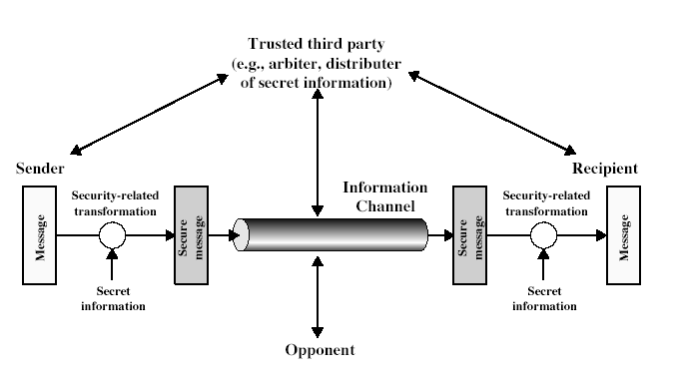
Model for Network Security

Slide 19
Model for Network Security
using this model requires us to:
design a suitable algorithm for the security transformation
generate the secret information (keys) used by the algorithm
develop methods to distribute and share the secret information
specify a protocol enabling the principals to use the transformation and secret information for a security service

Slide 20
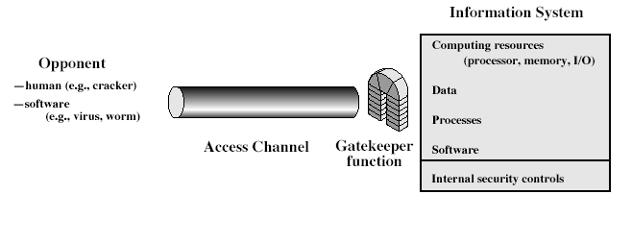
Model for Network Access Security

Slide 21
Model for Network Access Security
using this model requires us to:
select appropriate gatekeeper functions to identify users
implement security controls to ensure only authorised users access designated information or resources
trusted computer systems may be useful to help implement this model

Slide 22
Classical Substitution Ciphers
where letters of plaintext are replaced by other letters or by numbers or symbols
or if plaintext is viewed as a sequence of bits, then substitution involves replacing plaintext bit patterns with ciphertext bit patterns

Slide 23
Caesar Cipher
earliest known substitution cipher
by Julius Caesar
first attested use in military affairs
replaces each letter by 3rd letter on
example:
meet me after the toga party
PHHW PH DIWHU WKH WRJD SDUWB

Slide 24
Caesar Cipher
can define transformation as:
a b c d e f g h i j k l m n o p q r s t u v w x y z
D E F G H I J K L M N O P Q R S T U V W X Y Z A B C
mathematically give each letter a number
a b c d e f g h i j k l m n o p q r s t u v w x y z
0 1 2 3 4 5 6 7 8 9 10 11 12 13 14 15 16 17 18 19 20 21 22 23 24 25
then have Caesar cipher as:
c = E(p) = (p + k) mod (26)
p = D(c) = (c – k) mod (26)

Slide 25
Cryptanalysis of Caesar Cipher
only have 26 possible ciphers
A maps to A,B,..Z
could simply try each in turn
a brute force search
given ciphertext, just try all shifts of letters
do need to recognize when have plaintext
eg. break ciphertext "GCUA VQ DTGCM"

Slide 26
Monoalphabetic Cipher
rather than just shifting the alphabet
could shuffle (jumble) the letters arbitrarily
each plaintext letter maps to a different random ciphertext letter
hence key is 26 letters long
Plain: abcdefghijklmnopqrstuvwxyz
Cipher: DKVQFIBJWPESCXHTMYAUOLRGZN
Plaintext: ifwewishtoreplaceletters
Ciphertext: WIRFRWAJUHYFTSDVFSFUUFYA

Slide 27
Monoalphabetic Cipher Security
now have a total of 26! = 4 x 1026 keys
with so many keys, might think is secure
but would be !!!WRONG!!!
problem is language characteristics

Slide 28
Language Redundancy and Cryptanalysis
human languages are redundant
eg "th lrd s m shphrd shll nt wnt"
letters are not equally commonly used
in English E is by far the most common letter
followed by T,R,N,I,O,A,S
other letters like Z,J,K,Q,X are fairly rare
have tables of single, double & triple letter frequencies for various languages

Slide 29
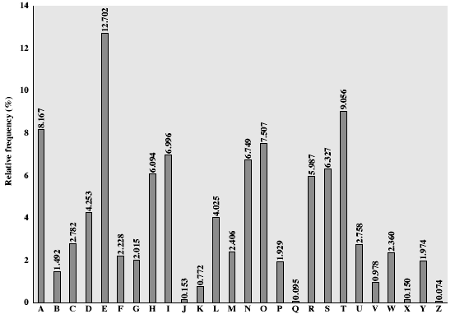
English Letter Frequencies

Slide 30
Use in Cryptanalysis
key concept - monoalphabetic substitution ciphers do not change relative letter frequencies
discovered by Arabian scientists in 9th century
calculate letter frequencies for ciphertext
compare counts/plots against known values
if caesar cipher look for common peaks/troughs
peaks at: A-E-I triple, NO pair, RST triple
troughs at: JK, X-Z
for monoalphabetic must identify each letter
tables of common double/triple letters help

Slide 31
Example Cryptanalysis
given ciphertext:
UZQSOVUOHXMOPVGPOZPEVSGZWSZOPFPESXUDBMETSXAIZ
VUEPHZHMDZSHZOWSFPAPPDTSVPQUZWYMXUZUHSX
EPYEPOPDZSZUFPOMBZWPFUPZHMDJUDTMOHMQ
count relative letter frequencies (see text)
guess P & Z are e and t
guess ZW is th and hence ZWP is the
proceeding with trial and error finally get:
it was disclosed yesterday that several informal but
direct contacts have been made with political
representatives of the viet cong in moscow

Slide 32
Hill cipher
Hill cipher is a polygraphic substitution cipher based on linear algebra.
Each letter is represented by a number modulo 26. Often the simple scheme A = 0, B = 1, …, Z = 25 is used, but this is not an essential feature of the cipher.
To encrypt a message, each block of n letters (considered as an n-component vector) is multiplied by an invertible n × n matrix, against modulus 26.

Slide 33
To decrypt the message, each block is multiplied by the inverse of the matrix used for encryption.
The matrix used for encryption is the cipher key, and it should be chosen randomly from the set of invertible n × n matrices (modulo 26).
Examples
Input : Plaintext: ACT
Key: GYBNQKURP
Output : Ciphertext: POH

Slide 34
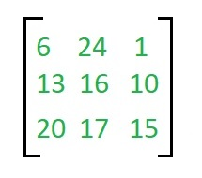

Encryption
We have to encrypt the message ‘ACT’ (n=3).
The key is ‘GYBNQKURP’ which can be written as the nxn matrix:
The message ‘ACT’ is written as vector:

Slide 35
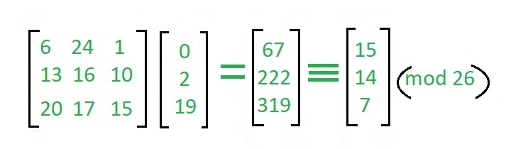
The enciphered vector is given as:
which corresponds to ciphertext of ‘POH’

Slide 36
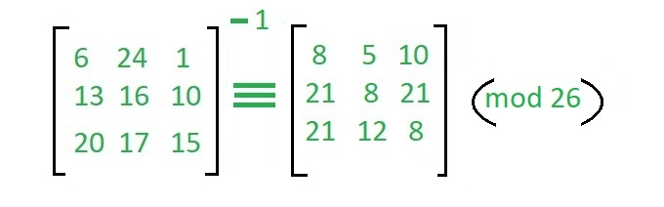
Decryption
To decrypt the message, we turn the ciphertext back into a vector, then simply multiply by the inverse matrix of the key matrix (IFKVIVVMI in letters)

Slide 37
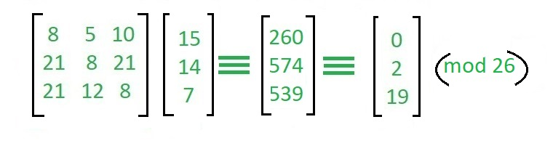
For the previous Ciphertext ‘POH’:
which gives us back ‘ACT’.

Slide 38
Playfair Cipher
not even the large number of keys in a monoalphabetic cipher provides security
one approach to improving security was to encrypt multiple letters
the Playfair Cipher is an example
invented by Charles Wheatstone in 1854, but named after his friend Baron Playfair

Slide 39
Playfair Key Matrix
a 5X5 matrix of letters based on a keyword
fill in letters of keyword (sans duplicates)
fill rest of matrix with other letters
eg. using the keyword MONARCHY
M | O | N | A | R
C | H | Y | B | D
E | F | G | I/J | K
L | P | Q | S | T
U | V | W | X | Z

Slide 40
Encrypting and Decrypting
plaintext is encrypted two letters at a time
if a pair is a repeated letter, insert filler like 'X’
if both letters fall in the same row, replace each with letter to right (wrapping back to start from end)
if both letters fall in the same column, replace each with the letter below it (again wrapping to top from bottom)
otherwise each letter is replaced by the letter in the same row and in the column of the other letter of the pair

Slide 41
Security of Playfair Cipher
security much improved over monoalphabetic
since have 26 x 26 = 676 digrams
would need a 676 entry frequency table to analyse (verses 26 for a monoalphabetic)
and correspondingly more ciphertext
was widely used for many years
eg. by US & British military in WW1
it can be broken, given a few hundred letters
since still has much of plaintext structure

Slide 42
Polyalphabetic Ciphers
polyalphabetic substitution ciphers
improve security using multiple cipher alphabets
make cryptanalysis harder with more alphabets to guess and flatter frequency distribution
use a key to select which alphabet is used for each letter of the message
use each alphabet in turn
repeat from start after end of key is reached

Slide 43
Vigenère Cipher
simplest polyalphabetic substitution cipher
effectively multiple caesar ciphers
key is multiple letters long K = k₁ k₂ ... k_{d}
i^{th} letter specifies i^{th} alphabet to use
use each alphabet in turn
repeat from start after d letters in message
decryption simply works in reverse

Slide 44
Example of Vigenère Cipher
write the plaintext out
write the keyword repeated above it
use each key letter as a caesar cipher key
encrypt the corresponding plaintext letter
eg using keyword deceptive
key: deceptivedeceptivedeceptive
plaintext: wearediscoveredsaveyourself
ciphertext:ZICVTWQNGRZGVTWAVZHCQYGLMGJ

Slide 45
One-Time Pad
if a truly random key as long as the message is used, the cipher will be secure
called a One-Time pad
is unbreakable since ciphertext bears no statistical relationship to the plaintext
since for any plaintext & any ciphertext there exists a key mapping one to other
can only use the key once though
problems in generation & safe distribution of key

Slide 46
Modern Block Ciphers
now look at modern block ciphers
one of the most widely used types of cryptographic algorithms
provide secrecy /authentication services
focus on DES (Data Encryption Standard)
to illustrate block cipher design principles

Slide 47
Block vs Stream Ciphers
block ciphers process messages in blocks, each of which is then en/decrypted
like a substitution on very big characters
64-bits or more
stream ciphers process messages a bit or byte at a time when en/decrypting
many current ciphers are block ciphers
broader range of applications

Slide 48
Block Cipher Principles
most symmetric block ciphers are based on a Feistel Cipher Structure
needed since must be able to decrypt ciphertext to recover messages efficiently
block ciphers look like an extremely large substitution
would need table of 2⁶⁴ entries for a 64-bit block
instead create from smaller building blocks
using idea of a product cipher

Slide 49
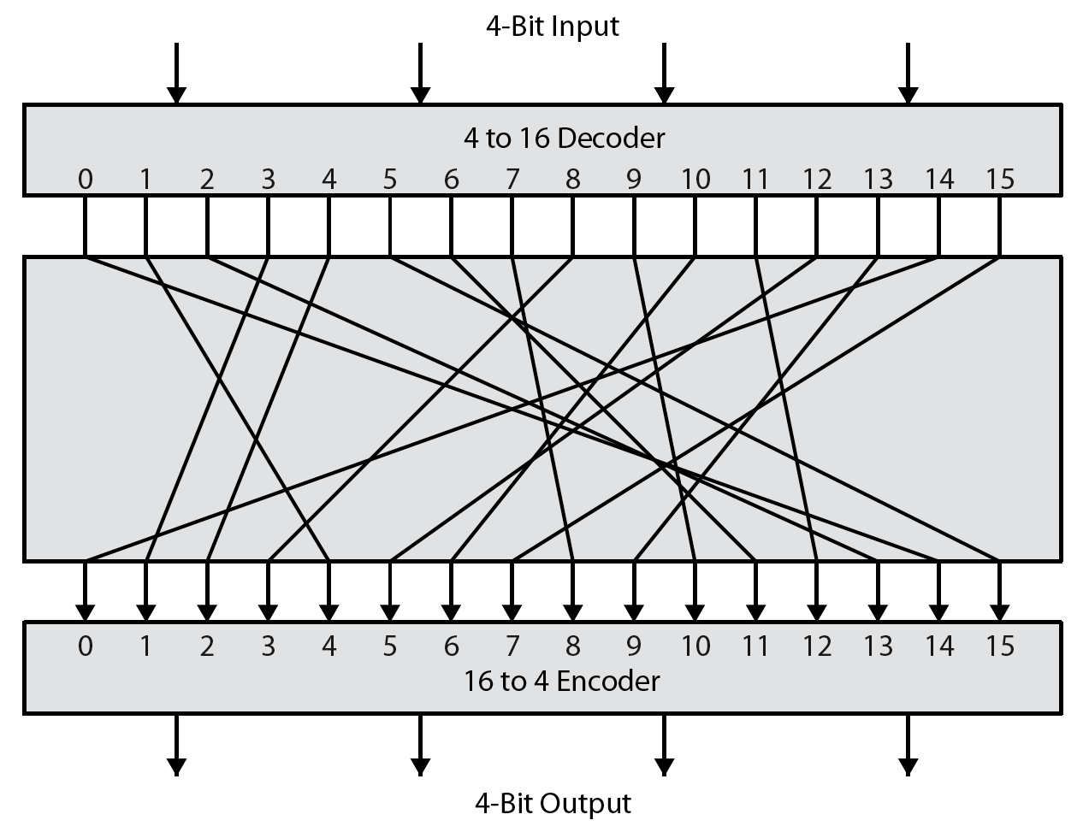
Ideal Block Cipher

Slide 50
Claude Shannon and Substitution-Permutation Ciphers
Claude Shannon introduced idea of substitution-permutation (S-P) networks in 1949 paper
form basis of modern block ciphers
S-P nets are based on the two primitive cryptographic operations seen before:
substitution (S-box)
permutation (P-box)
provide confusion & diffusion of message & key

Slide 51
Confusion and Diffusion
cipher needs to completely obscure statistical properties of original message
a one-time pad does this
more practically Shannon suggested combining S & P elements to obtain:
diffusion – dissipates statistical structure of plaintext over bulk of ciphertext
confusion – makes relationship between ciphertext and key as complex as possible

Slide 52
Feistel Cipher Structure
Horst Feistel devised the feistel cipher
based on concept of invertible product cipher
partitions input block into two halves
process through multiple rounds which
perform a substitution on left data half
based on round function of right half & subkey
then have permutation swapping halves
implements Shannon’s S-P net concept

Slide 53
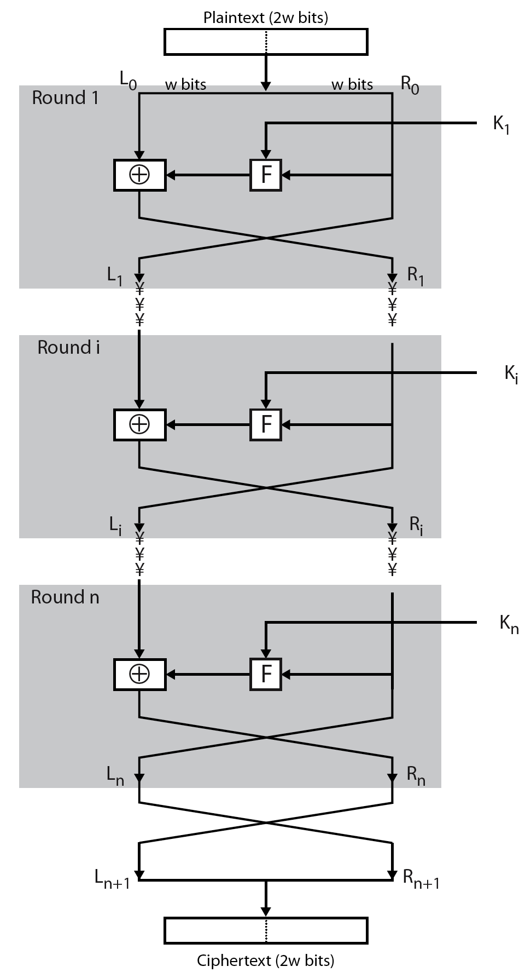
Feistel Cipher Structure

Slide 54
Feistel Cipher Design Elements
block size
key size
number of rounds
subkey generation algorithm
round function
fast software en/decryption
ease of analysis

Slide 55
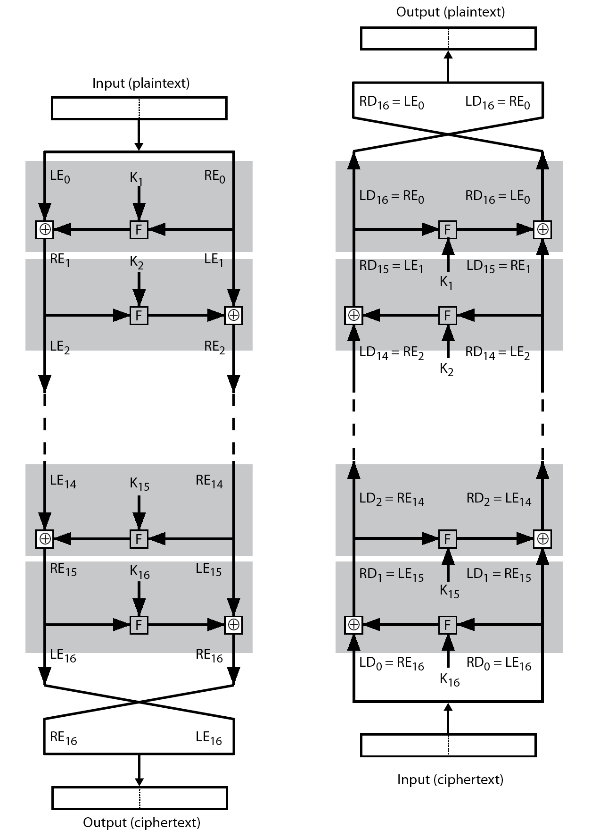
Feistel Cipher Decryption

Slide 56


